Slide 1

Paving the way to a greener world

Slide 2
AGRICULTURE

Slide 3
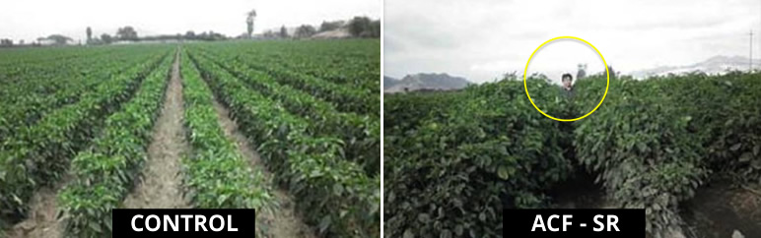
  Chili Pepper Trial in Peru
  Treated with 4 Liters of ACF-32 per Ha / Month
  Increased Crop Yield by 35%

Slide 4
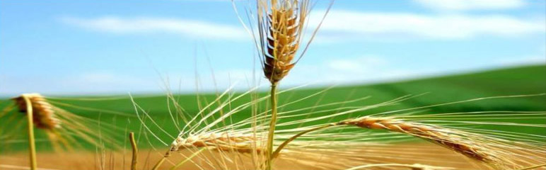
  Spring Wheat Mexico
  ACF 32 Plants produced 75% more seed stems than the Control:
  Normal plants have 4 to 7 seed stems
  ACF 32 plants had 7 to 10 seed stems
  Faster growth and development
  Increased wheat production by 60%

Slide 5
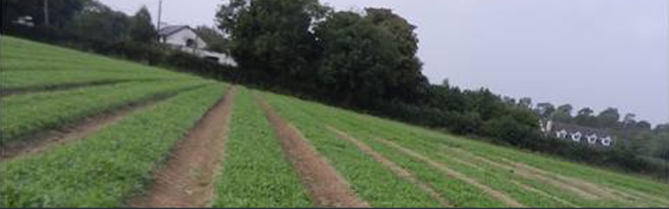
  Micro-Crops in Ireland
  Italian Rocket, Baby Leaf, Spinach, Purple Chard:
  Using ACF-32 improved plant vitality, root development, and resistance to mold and mildew
  No chemicals, therefore no harvest delays
  Improved yield and leaf quality

Slide 6
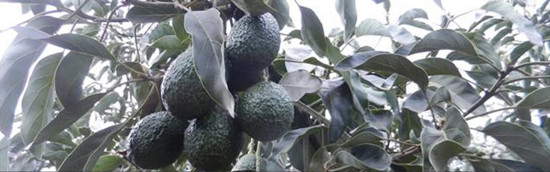
Avocado Trial in Kenya
  Trial conducted in 7 year old grove
  Applied product by drip irrigation
  Treated with 4 Liters of ACF 32 per Ha every two weeks for the first 2 months and then one application monthly
  Yield was measured in crates and weight
    Increased crates by 145%
    Increased weight by 165%
    The fruits were of better quality and more uniform in size

Slide 7
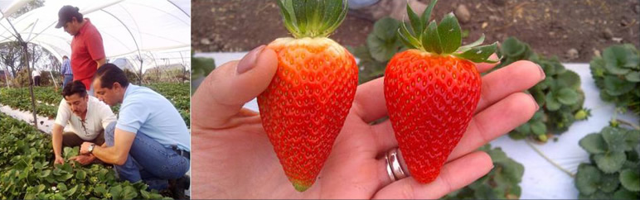
  Strawberries in Mexico
  Greater consistency and uniformity
  Better, more intense color
  Larger in size than control
  Taste better, sweeter, increased brix
  More fruits per plant, bigger crowns
  Increased yield by 45%

Slide 8
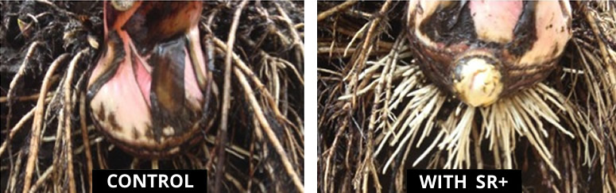
  Banana Plantation – Guatemala
  Banana production in Guatemala is expanding very quickly and represents an important export crop. Bananas are harvested on a continuous basis, and, therefore, the plantations are actually harvested year round.
  Dosage and Application
  ACF 32 was applied to the banana crop through the irrigation system via a large holding tank through which pesticides and fertilizers are normally added.
  The trial was conducted on a 5 Ha plot with a dosage of 3 liters per month of ACF 32 per hectare via daily irrigation.
  Root Growth
  After 5 months, the root growth of the banana trees had significantly improved in comparison to the control. This was evidenced by the number and size of roots present in the photograph which ultimately resulted in a stronger plant structure and a greater ability to withstand high winds from seasonal storms.

Slide 9
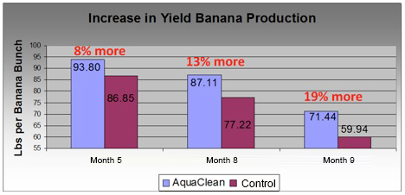
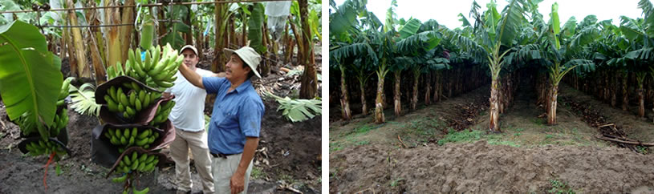
  Banana Yield Production
  After 5 months, the treated area showed an increased banana yield of 19% as measured by overall weight. The treated banana trees showed significant increases in size, volume and the number of healthy new roots visible. Additionally, floor litter composting was significantly accelerated and produced a better nutrient profile which resulted in a significant reduction of subsequent fertilizer expense.

Slide 10
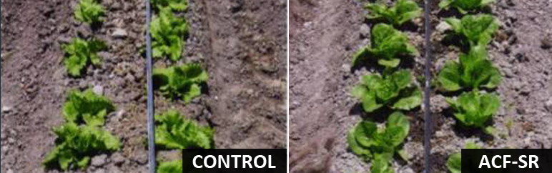
  Lettuce in Mexico
  ACF-32 Plants recovered from root stress while the control did not
  Better quality heads for export were produced
  Increased plant growth with more intense color in the leaves was observed
  38% overall increase in production of lettuce as measured by weight

Slide 11
CROP YIELD

Slide 12
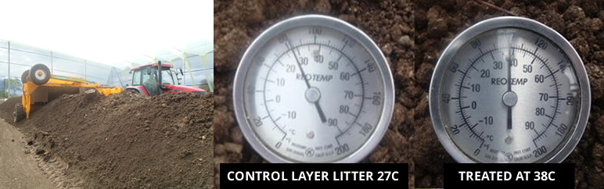
  Poultry Layer Barn
  Manure Management Composting Method
  Layer Litter composting time reduced from 32 days to 27 days with the application of Aqua Clean.
    ACF-32 applied during aeration process twice weekly
    No bacteria product was used in the Control
    Treated layer litter achieved a process temperature of 38c while the control temperature did not surpass 27c.
  Results:
    Better settling, nutrient composition and fertilizer value with no presence of odors.

Slide 13
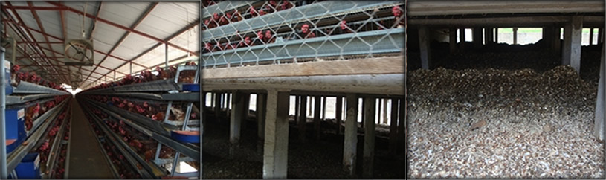
Manure Compost – Below Barn Method
  ACF-32 treated litter significantly reduced compost time by 30% or 15 days, exceeding expectations
  Odor was significantly reduced, allowing for land-farming without neighbor complaints
  Compost had better settling qualities and nutrient composition / concentration

Slide 14
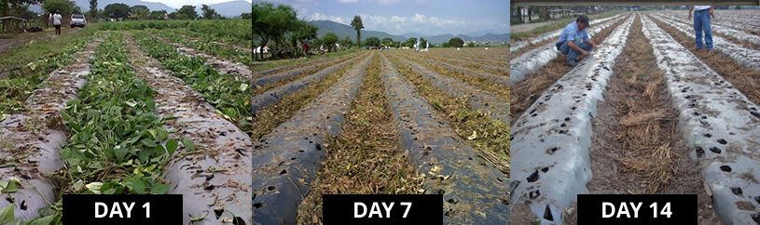
  French Bean In-Field Composting
  Farmers typically must remove the plants post-harvest as the time required to compost in-field takes far too long, produces strong odors and attracts harmful flies.
  With the spray application of ACF-32, in-field composting became viable which resulted in significant labor cost savings and an improved nutrient profile for the finished product.

Slide 15
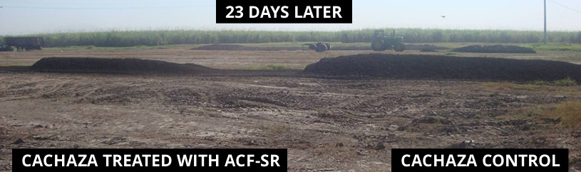
  Sugar Cane – Cachaza Composting
  Cachaza is a by-product of sugar production consisting of the remaining solids after juice extraction. Objective was to accelerate process time and improve compost quality as a bio-fertilizer.
  Cachaza Quality
  Improved mineralization and increased nitrogen, phosphorus, and calcium concentrations by 22%, 24% and 26% respectively while reducing salt content by 53%.

Slide 16
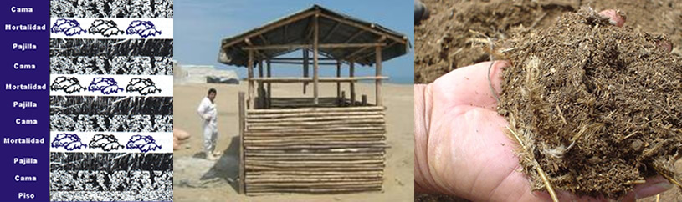
  COMPOSTING – Poultry MORTALITY USING AQUACLEAN ACF-32 BROILER FARM in NORTHERN PERu
  Organic waste is layered in shed, consisting of 5 cm of poultry manure, chopped straw and mortality
  AquaClean is sprayed on top of each layers and applied until the compost mixture reaches 1.5m
  This process is completed in approximately 52 days
  The temperature begins to decrease between 30 to 40 days indicating that the material has been digested. When temperature drops to 30°C, biomass is considered ready for use as fertilizer similar to brown humus

Slide 17
MANURE MANAGEMENT

Slide 18
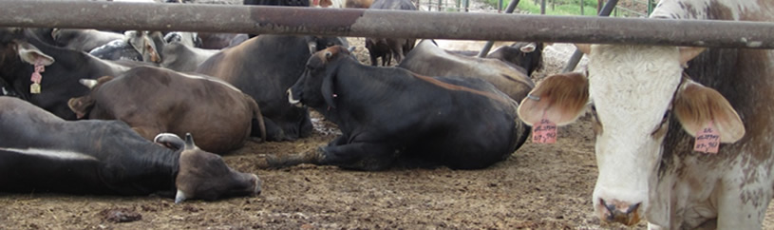
  Feedlot in Veracruz, Mexico
  Ranch capacity: 22,000 head of cattle
  15 retention pits collect the manure before flowing into the lagoons
  Manure then flows into a gravity fed, dual lagoon system
  Problems
  Contamination of the river that runs through the property
  Neighbor complaints of odors and solids
  Pressure and fines from the EPA
  Objectives
  Eliminate the organic waste matter in all lagoons
  Eliminate the organic crusts covering the lagoons
  Improve the quality of the discharge water
  Stop polluting the river and downstream restoration

Slide 19
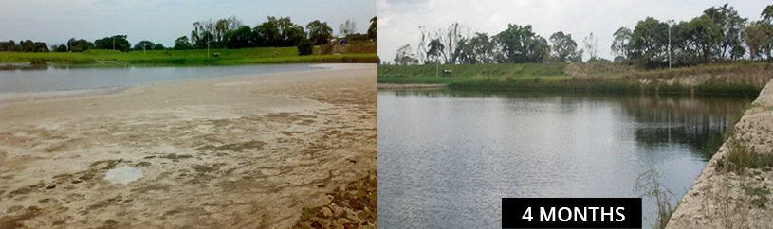
Treatment Using AquaClean ACF-32 Four Months – Goals Accomplished
  Removal of hard organic matter cover and significant reduction of organic sludge in all of the lagoons
  Biological remediation of the lagoons without the need for chemicals or expensive dredging techniques
  Final effluent quality met discharge requirements
  River was restored to its natural state and wildlife returned

Slide 20
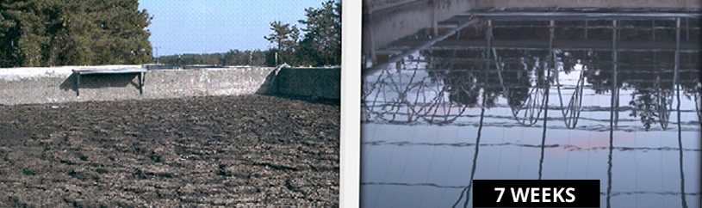
  South Korea Swine Production
  Problems: Thick crust over lagoon causing strong odors
  ACF-32 was applied directly to the lagoon with the following results:
    After 3 weeks –floating solids were reduced and broken up
    After 4 weeks – solids were dissolved into slurry form
    After 5 weeks – all floating solids were eliminated
    Final – total odor elimination and reduction in BOD of 70%
    Effluent discharge requirements were met
    Created land farming opportunity
    No odor when applied to fields
    Increased fertilizer value
    Corn yield increased by 50%

Slide 21
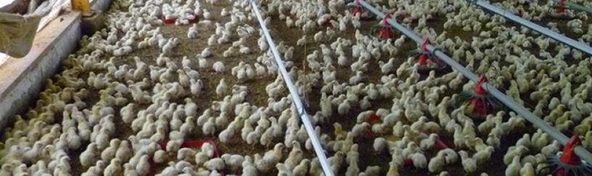
  Poultry Broiler Bedding AquaClean, diluted and applied to bedding
  Significant ammonia reduction
  Increased bedding utility
  Dosage rate:
    4 Liters of ACF-32 per 1,000 m²
    Applied twice during 6 week grow-out

Slide 22
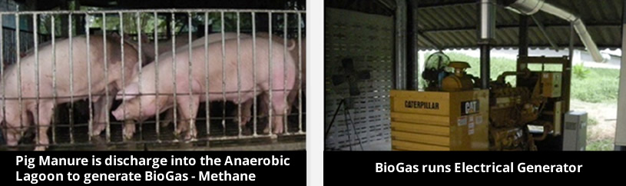
  BioGas – Methane from Swine Manure ACF-32 APPLIED TO THE MANURE COLLECTION LAGOONS:
  Increase in BioGas – methane production rose by 30%
  Significant reduction in Hydrogen Sulfide H2S and corrosion of equipment
  Reduction of sludge generation resulting in lower maintenance and handling costs
  Increase in fertilizer value of discharge effluent
  Odorless land-farming

Slide 23
SOIL ENHANCEMENT

Slide 24
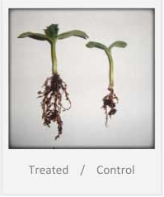
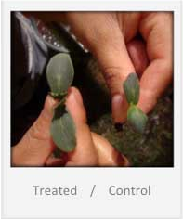
  Green House Trials
  ACF- 32 was applied twice to soil: First when cucumber seeds were planted and again after 15 days. Transplanting occurred after 30 days.
  ACF- 32 restores depleted soil, composts organic matter, and increases biological activity. This produces a significant increase in plant nutrient absorption and root growth stimulation while reducing water and fertilizer needs.

Slide 25
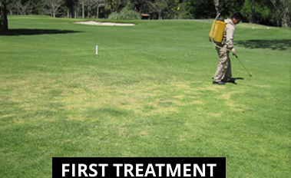
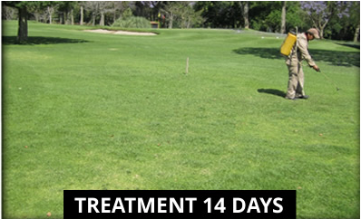
  Direct Soil Enrichment
  AquaClean restores nature’s biological activity in the soil…
  Ensures complete degradation of organic matter
  Improves soil structure, porosity and water retention
  Better root growth and nutrient absorption
  Reduces fertilizer needed
  Green Grass Professionals agree that using ACF-32 improves root growth and lowers the need for irrigation and chemical controls.

Slide 26
AQUACULTURE

Slide 27
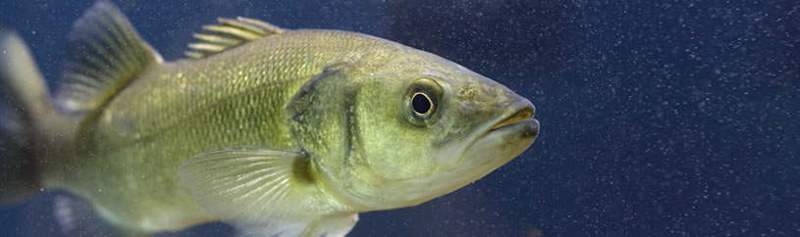
AquaClean
  ACF HAS A PROBIOTIC EFFECT, PROMOTING A CLEANER AND HEALTHIER ENVIRONMENT AND SIGNIFICANTLY REDUCING THE FOLLOWING PARAMETERS:
    BOD (Organics)
    TSS (Solids)
    Odor
    Sludge
    Ammonia
    Nitrogen
  Sea Bass Hatchery
  100,000 Larva typically produced 25 – 30k fingerlings.
  ACF treated incubation tanks increased fingerling production to 75k, resulting in an increased yield of over 100%

Slide 28
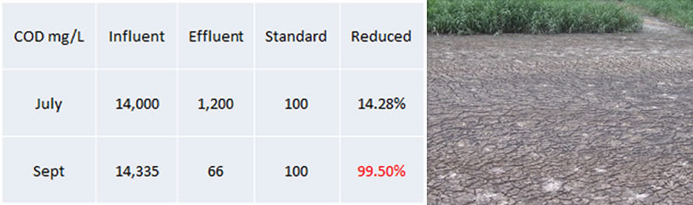
  Tri Hung – Fish Processing Plant
  Vietnamese Processing Facility produces 100m3 of highly polluted wastewater per day
  Discharge contains COD levels of over 14,000 ppm with high levels of FOGs
  A simple, low tech, lagoon system was used to capture and treat waste
  Effluent could not meet regulatory standards
  AQUA-CLEAN reduced COD by 99.5% and final effluent was in compliance

Slide 29
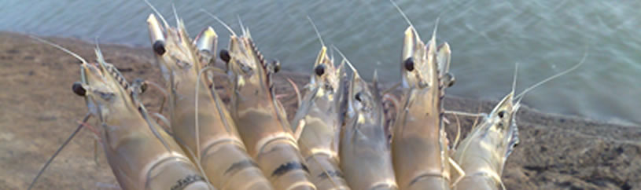
  Shrimp Treatment & Benefits
  TOTAL TREATMENT OF 30 GALLONS PER HECTARE DURING A FIVE-MONTH GROW-OUT SEASON
  Total yield, as measured by individual growth, increased by over 20% which also resulted in a higher, more valuable grade being produced
  A probiotic effect demonstrated better health, lower mortality rate, and improved feed conversion by 14%
  Significant reduction in sludge which resulted in faster turnaround, lower costs, and the possibility of a second grow-out season
  Improved water quality to meet environmental discharge requirements

Slide 30
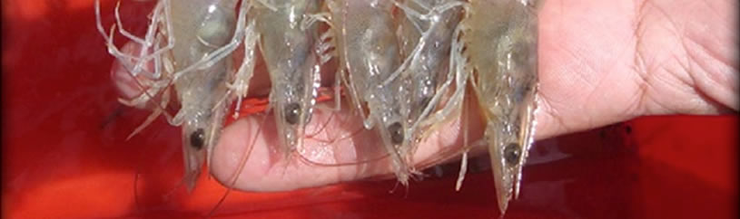
  Guatemala Shrimp Trial
  Objectives
  Sludge Reduction
  Lower Maintenance
  Increased Weight Gain & Yield
  Improved Uniformity at Harvest
  Stabilized and Better Water Quality
  Benefits
  Sludge completely oxidized and was reduced by 85%
  Treated Groups had better water quality, even though they had higher stocking density
  Treated Groups had better growth rates, an 18 to 20% increase in yield and significant reduction in time needed to achieve target grow-out weight

Slide 31
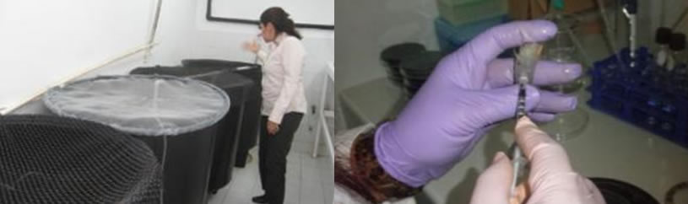
  Shrimp Trials for ProBiotic Effect
  WHITE SHRIMP “LITOPENAEUS VANNAMEI” LARVA STUDY FOR IMMUNE RESPONSE
  Laboratory Study in Mexico
  ACF was applied to shrimp larva grow-out tanks and the following results were noted after 3 weeks:
    14% increase in survival rate
    10% increase in growth rate
    200% better immune response as measured by density of vibrios on hemolymph blood work
    Vastly improved water quality

Slide 32
INDUSTRIAL

Slide 33
  Wastewater
  South African Winery – COD reduction of 94% and total elimination of odors
  Dairy and Juice Plant in Panama – aquatic life returned in 8 weeks to a previously septic wastewater lagoon
  Blue Jean Wastewater – reduced pond discharge waters to 3 BOD
  Coca-Cola Bottling in El Salvador – reduced COD by 84%
  Palm Oil Effluent in Malaysia – significantly reduced organic bottom sludge and improved overall system performance
  South African Dairy Processor – COD reduction of 60%, sludge disposal quantities reduced by 83%
  Tannery in South Africa – 80% sludge reduction, 60% increase in throughput
  Mexican Poultry Abattoir – eliminated odors and met EPA discharge standards in 3 months

Slide 34
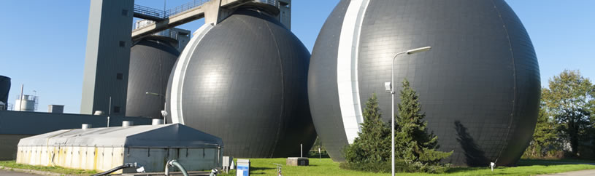
  Korean Anaerobic Digester
  Flow 1,644 m3 per day
  Dosage 2.5 gallon per day
  Digestion efficiency increase from 29.4% to 56.1%
  Methane Gas generation increased by 40%, more electricity generated
  Reduced sludge generation, lowering handling and removal cost by 40%
  Reduced use of polymeric flocculants
  Overall economic gain of US$1000 per day

Slide 35
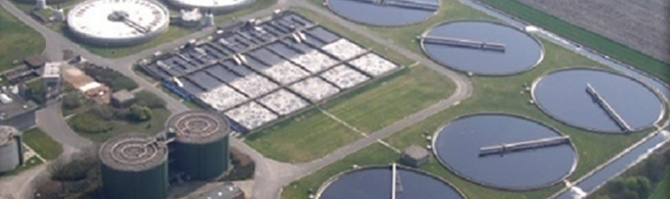
  Zeeland WWS, Holland
  Lowered Sludge 28%
  Reduced BOD & COD
  Eliminated Odor
  Stabilized Winter Ops
  Lowered Operating Cost
  System designed for 535K PE

Slide 36
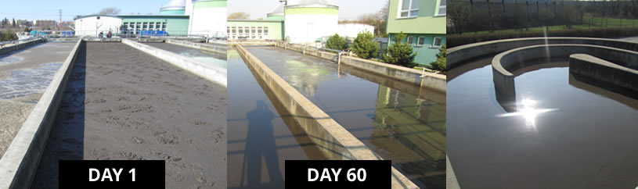
  Rousínov WWS – Czech Carrousel – Race Tack – System
  System designed to create aerobic zone for BOD Removal and Nitrification, flowing to anoxic zone for denitrification…
  ACF-32 improved reduction of BOD and COD by 68%, and the removal efficiency of total nitrogen pollution by 61%
  Decreased sludge from an average of 240 ml/g to 130, dramatically improving settling properties by 64% and reduced organics in stabilized sludge

Slide 37
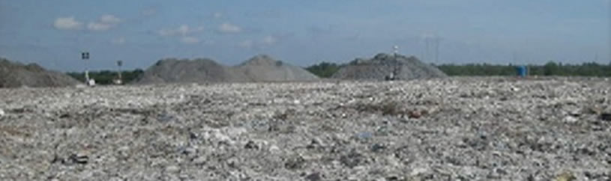
  Solid Landfill Application
  Municipal Landfill Vietnam, eliminated odors sustainably
  Used AquaClean for “Odor Control”
  Diluted 1:100 with fresh water
  Sprayed evenly at ½ Liter per m2 over surface of newly dump waste
  Completely eliminate bad odor
  Improve organic break up in solid waste, better waste compaction
  Improve leachate water quality

Slide 38
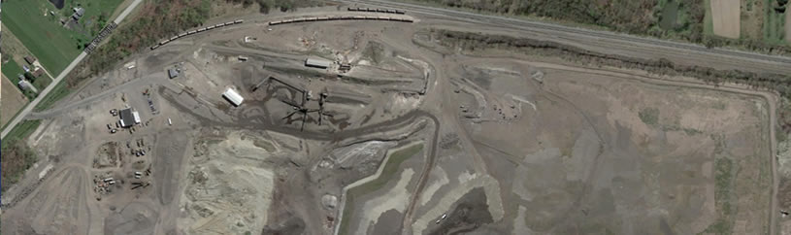
  Construction and Demolition Landfill Construction Recovery Disposal Facility, USA
  ACF-32 & ACF-SA diluted and applied through injection wells
  BOD reduced by 23%, COD by 70%
  H₂S in leachate reduced to non-detectable levels, odor eliminated
  Reduced Ammonia by 19% and Phosphate by 50%
  Reduced transportation costs for leachate removal

Slide 39
ENVIRONMENTAL AND OPEN WATER

Slide 40
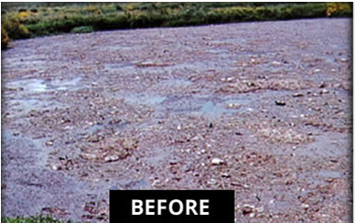
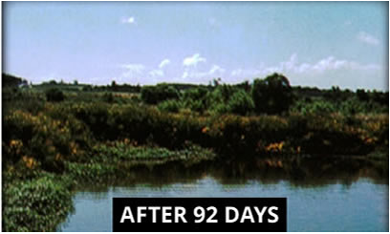
Ponds, lake, rivers
  Lake Remediation in Uruguay
  Environmental pollution:
    Pond and sewage runoff eliminated village water supply
    Additional issue: remote area without electricity for aeration
  AquaClean treatment:
    Using ACF-32, able to restore natural balance in three months

Slide 41
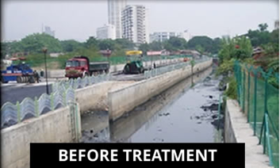
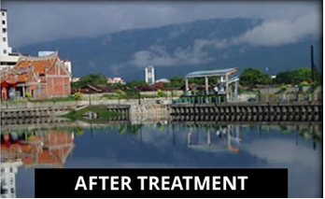
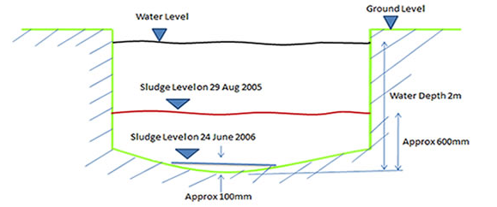
  Penang Flood Retention Pond
  Malaysia River Problems:
  Bad Odor
  Thick Bottom Sludge
  High discharge BOD and COD
  Working with the Malaysia Irrigation and Drainage Department in 2005…
  Bad Odors eliminated within 2 weeks
  Significantly reduced BOD and COD, by 90% in 8 months
  600mm thick bottom sludge degraded by over 85% within 8 months

Slide 42
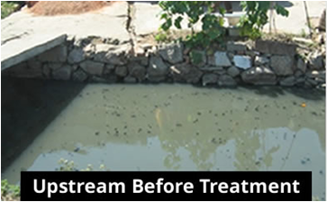
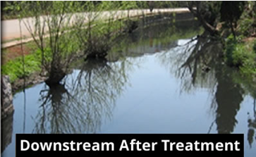
  Xiba River, Kunming, China
  Treatment Objectives:
  Reduce Levels of Pollutants in River: BOD, COD, Total Nitrogen, Phosphate, Total Suspended Solids, etc.
  Restore Habitat Suitable for Higher Microscopic Life Forms and Other Aquatic Life
  Reduce Odors in the Vicinity of the River
  Challenges:
  Treat Flowing River Without Impeding Flow, with Minimum Disruption to River and Surrounding Areas
  Treat at Reasonable, Sustainable Costs
  Treatment Program:
  Model River, Establish Monitoring Points to Prove Effectiveness of Model
  Use “Bio-Media Zones” to Establish Fixed Film to
    Treat river in media zones and…
    Release microorganisms to treat river further downstream of media zones

Slide 43
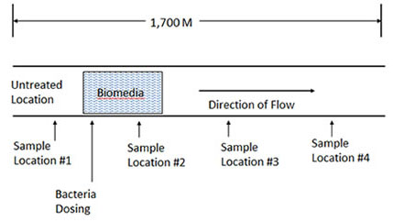
Xiba River Remediation Project - Process Diagram for Treatment
  Results:
  Significantly Reduced Odors in First 30 Days
  Up to 60% Reduction in Most Pollutants
  Higher Life Forms Returned After 60 Days
  Aquatic Life Began to Thrive After 90 Days
  “The Toxicity Was Eliminated from the River” – Dr. Hu Kaelin, Professor, University of Kunming

Slide 44
Thank You!

