Slide 1

Paving the way to a greener world

Slide 2
We provide biotech solutions to environmental problems in:
Agriculture
Aquaculture
Industrial, Municipal
Hotels and Restaurants
Commercial
Open Water and Soil

Slide 3
We deal with:
AquaClean™
Products are developed and have been proven effective for over 34 years in the market.
Over 30 Year experience in culture selection, product design and bio formulation, as well as technical support.

Slide 4

Our products are all natural and derived
from the environment.
They are non-pathogenic, non-toxic & safe
for humans, animals, plants & aquatic life.
They have been approved for use by the
U.S Department of Agriculture (USDA).

Slide 5
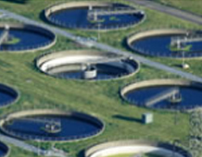
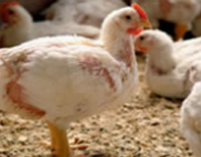
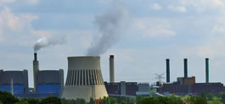
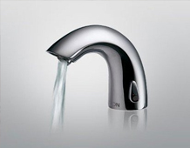
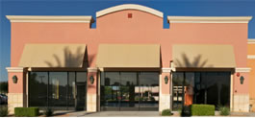
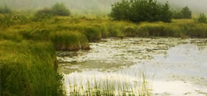

Our Areas of Application:
Municipal Agricultural Industrial
Hotels & Commercial Open Water
Restaurants & Soil

Slide 6
Municipal:
Developed & implemented treatment plans based on individual needs of major municipal sewage plants around the world.
It helps in:
Improving organic removal efficiency.
Improving nitrification.
Improving oil & grease digestion.
Reducing sludge.
Expanding plant capacity without capital expenditures etc.

Slide 7
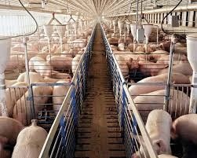
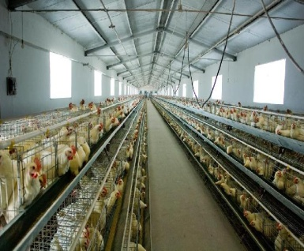
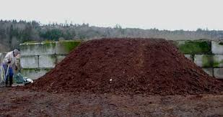
Agricultural:
Our products have proven benefits such as:
Lowering operational costs.
Improving overall health and the environment.
Providing greater profits to the agricultural market.
It helps in:
Swine farm Poultry farm Manure Management
benefits benefits

Slide 8
Swine farm benefits:
Reduced sludge and solid waste.
Eliminates odor from lagoons.
Lowers manure handling costs.
Improves fertilizer value.
Increases bio-gas generation.
Reduces insect infestations.

Slide 9
Poultry farm benefits:
Reduced Ammonia and odor.
Extends bedding life.
Faster composting of manure.
Pro-biotic drinking water effect.
Reduced mortality rate.
Healthier barn environment.

Slide 10
Manure Management:
Improved composting.
Effective odor control.
Environmental pro-biotic effect.
Better effluent discharge.
Enhances bio-gas generation.
Eliminates Hydrogen sulphide (H₂S)

Slide 11
Industrial:
AquaClean™ is effective at lowering effluent wastes and following local regulations in different industries. It helps in:
Improving performances of systems with inadequate aeration capacity.
Improving plant capacity.
Improving breakdown of refractory organics.
Improving solid settling.
Improving oil & grease digestion.

Slide 12
Hotels & Restaurants:
Grease & oil are natural by-products of hotels & restaurants.
These by-products often lead to clogged drains, backups & rancid odours.
Our products reduce service time in system
clean-out & pump-out of both septic tanks &
grease traps. It helps in:
- Eliminating hard surface grease on tanks.
- Reducing build-up of grease balls & grease chunks.
- Improving system effluent drain field flow performance.

Slide 13
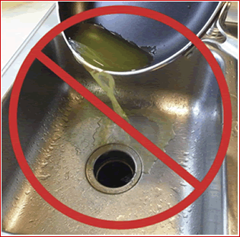
Oil, Grease & Fat Degrader
Biological breakdown of trapped grease, improved free-flow in drain lines .
Removes the cost of expensive plumbing work and potentially damaging rodding.
Complete digestion of solids, effective breakdown of waste.
Effective odor reduction, inhibits hydrogen sulphide and reduces risk of rodent and cockroach infestation.
Breakdown of all the organic components of waste associated with the drain environment
Reduce BOD levels, which in turn, reduces sewage costs

Slide 14
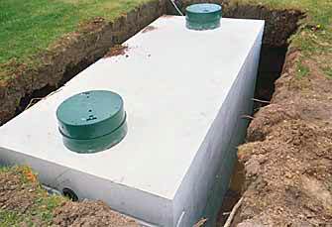
Septic Tank Treatment
Degrades solid waste and fats which reduces sludge build up
Avoids fats re- form and makes
it easier to maintain a healthy
septic tank.
Increases time period between pump outs
Pump outs are easier, as solids are broken down
Eliminates bad odors
Easy to use

Slide 15
Commercial:
If you or your customers have a grease
problem, apply our AquaClean™ products &
see what benefits you receive.
With over 90% success rate, it helps in
restoring flow in commercial septic systems.
Removes hard to degrade fats, oils, grease (FOGs) that clog the drainage fields.

Slide 16
Open Water & Soil:
AquaClean™ is very effective for environmental
clean-ups of waterways polluted with organic
waste. It helps in:
- Improving health & stability of natural bodies
of open water.
- Restoring capacity to support aquatic life.
- Value for conservation & recreational
activities.

Slide 17
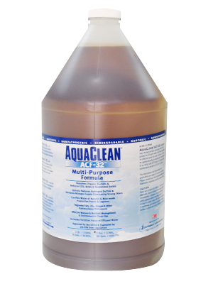
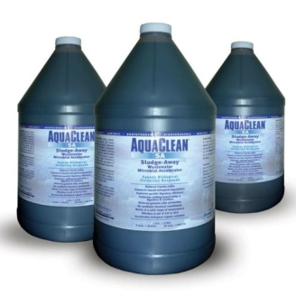
Our products:
ACF-32 SA

Slide 18
AquaClean™/ ACF-32:
Contains a blend of 12 select microorganisms.
Degrades organic matter in aerobic, facultative anaerobic and anaerobic wastewater systems, ponds, wastewater retention tanks etc.
Uses natural microorganisms to dissolve organic sludge and reduce COD, BOD and SS. It is not harmful to humans, animals and plants.
Reduces Hydrogen sulphide (H₂S), ammonia and nitrogen levels.
Controls strong odor.

Slide 19
…
Clarifies water in natural and man-made ponds and lagoons.
Degrades FOGs and other hydrocarbons.
Effective manure and nutrient management and cleans up the environment.
Increases fertilizer value.
Effectively works in a wide range of climatic and wastewater conditions working in pH levels from 4.0 to 10.0.

Slide 20
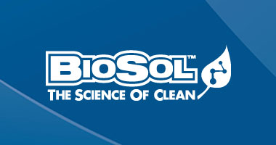
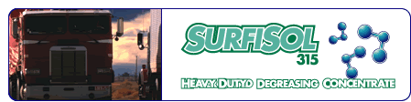
…From
…comes

Slide 21
In an effort to meet environmental & safety standards, common off the shelf solvents, surfactants and degreasers tend to sacrifice performance.
SurfiSol 315 not only meets but often exceeds those standards while increasing your performance requirements.

Slide 22
SurfiSol 315’s most remarkable feature is its ability to breaks the bonds of contaminants from a surface - quickly. By maintaining this separation, it provides faster wetting, aggressive penetration and overall better cleaning while rinsing totally free.

Slide 23
Applications:
Manufacturing plants- floors, maintenance/cleanup etc.
Camp facilities- kitchens, floors etc.
Steam cleaning.
Forest equipment- pulp & paper mills, saw mills.
Printing press maintenance.

Slide 24
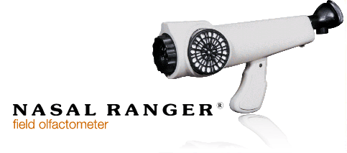
Another revolutionary product…

Slide 25
NASAL RANGER® field olfactometer:
An olfactometer is an instrument used to detect and measure ambient odor dilution.
NASAL RANGER® field olfactometer is a nasal organoleptic instrument used for measuring ambient odor, Dilution-to-threshold.

Slide 26
In short, our range of products is:
Providing reduction in BOD, COD & TSS in the
final effluent.
Providing reduction in system odor.
Providing rapid breakdown of fats, oils, grease (FOGs).
Promoting stable nitrification.
Increasing fertilizer value of manure.
Achieving breakdown of all the organic components of waste associated with drain environment.
Reducing sludge.
Hence, AquaClean™ ‘s effects are dramatic & cost-efficient.

Slide 27
Thank You!

